Slide 1
Fair Market Rent Pricing Exploration
An exploration of Fair Market Rent as it relates to various features

Slide 2
Fair Market Rent
Fair Market Rents, are estimates of 40th percentile gross rents for standard quality units within a metropolitan area or nonmetropolitan county.
Fair Market Rents, as set by the US Department of Housing and Urban Development (HUD) are used in the following circumstances:
To determine payment standard amounts for the Housing Choice Voucher program
To determine initial renewal rents for some expiring project-based Section 8 contracts
To determine initial rents for housing assistance payment (HAP) contracts in the Moderate Rehabilitation Single Room Occupancy program (Mod Rehab)
rent ceilings for rental units in both the HOME Investment Partnerships program and the Emergency Solution Grants program,
calculation of maximum award amounts for Continuum of Care recipients and the maximum amount of rent a recipient may pay for property leased with Continuum of Care funds, and calculation of flat rents in Public Housing unit

Slide 3
Exploring Rent Prices
We have chosen to analyze historic rent prices across the U.S. based on year, state, population, and number of bedrooms.
There is a plethora of datasets relating to historic real estate prices but surprisingly little when it comes to nationwide rent prices.

Slide 4
Fair Market Rent Dataset
We have used fair market rent datasets from the U.S. Department of Housing and Urban Development (HUD).
The dataset, provided in annual csv files, contains information on rental prices broken down by number of bedrooms, area name, county, state, population, and other classifiers around metro area and location information
The datasets are all available at the HUD website: https://www.huduser.gov/portal/datasets/fmr.html#2022

Slide 5
What will the dataset tell us?
With this dataset, our machine learning model will show:
What features have the greatest influence on rental prices?
How does change in features like location or population affect rental prices?
Which markets have shown the most dramatic increase in rent?
Which markets are predicted to have the smallest increase in rent prices?

Slide 6
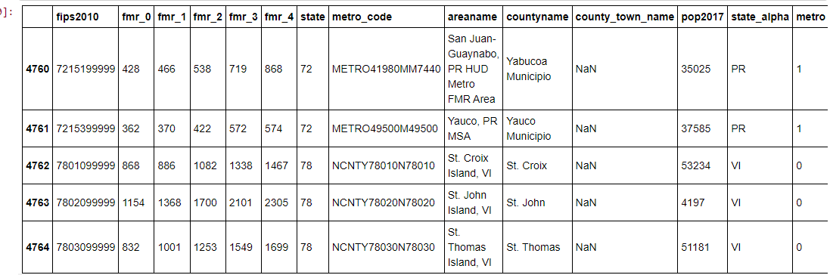
Raw data
Notes:
As loaded from HUD csv files

Slide 7
Data Exploration
The initial HUD datasets contained some data that required transformation and some excess data, including:
There were several columns such as state number, areaname, county_town_name, and metro that provided no insight to our model. Each of those columns were dropped.
The initial identifiers for studio and 1-4 bedrooms were renamed to more clearly label the data.
The ‘state_alpha’ column was renamed to ‘State’ for clarification and to allow for better grouping of the data.
The year was added as a column in each cleaned annual dataframe to be able to combine all the data grouped by state into a single dataframe to allow for trend analyzation.
Notes:
There were several columns such as state number, areaname, county_town_name, and metro that provided no insight to our model. Each of those columns were dropped.
The initial identifiers for studio and 1-4 bedrooms were renamed to more clearly label the data.
The ‘state_alpha’ column was renamed to ‘State’ for clarification and to allow for better grouping of the data.
The year was added as a column in each cleaned annual dataframe to be able to combine all the data grouped by state into a single dataframe to allow for trend analyzation.

Slide 8
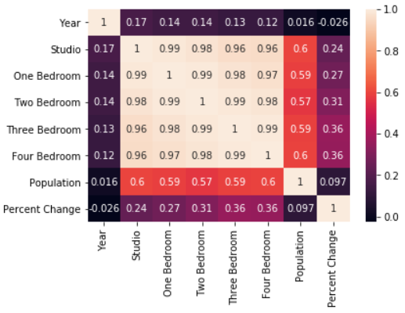
Exploratory Data Analysis
For each year’s set of data:
Rental prices were grouped and averaged by state.
Populations were also averaged to show the mean population per county within each state.
Dropped unnecessary columns
Renamed columns
Notes:
Rental prices were grouped and averaged by state. Populations were also averaged to show the mean population per county within each state.
The initial data was used to create separate data frames. After cleaning and grouping by state, the separate data frames were combined to include each year’s average rent prices by state from 2018-2022.
The heat map to the right tells us that year is not a great predictor of anything, likely because we only have 5 years of data, only by year, not by month.
Population appears to be the best moderate predictor with a trend from our data.
Price appears to gradually increase by year as well but has less Predictive Power.
A handful of states are above average in price (AK,CA,DC,GU,HI,MA,MD,NJ,NY,RI,VI)
Regardless of number of bedrooms, distributions of price are about the same.

Slide 9
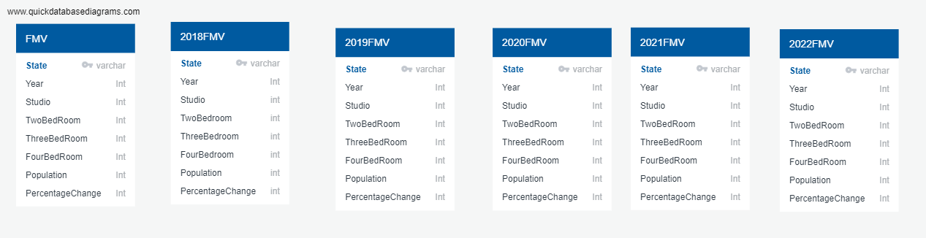
Database Explanation
Notes:
PostgreSQL Database Explanation.
Data ERD/ Scheme Prototype using QuickDatabaseDiagram.com
Update Year is Int, the remaining have float value
Import data source which in our case was a CSV file
Create 6 Identical tables that store the cleaned data in separate columns as follows;
State, Year, Studio, One Bedroom, Two Bedrooms, Three Bedrooms, Four Bedroom, Population, Percentage Change
Static Database, Data warehouse is designed to gather, clean and store data for use.

Slide 10
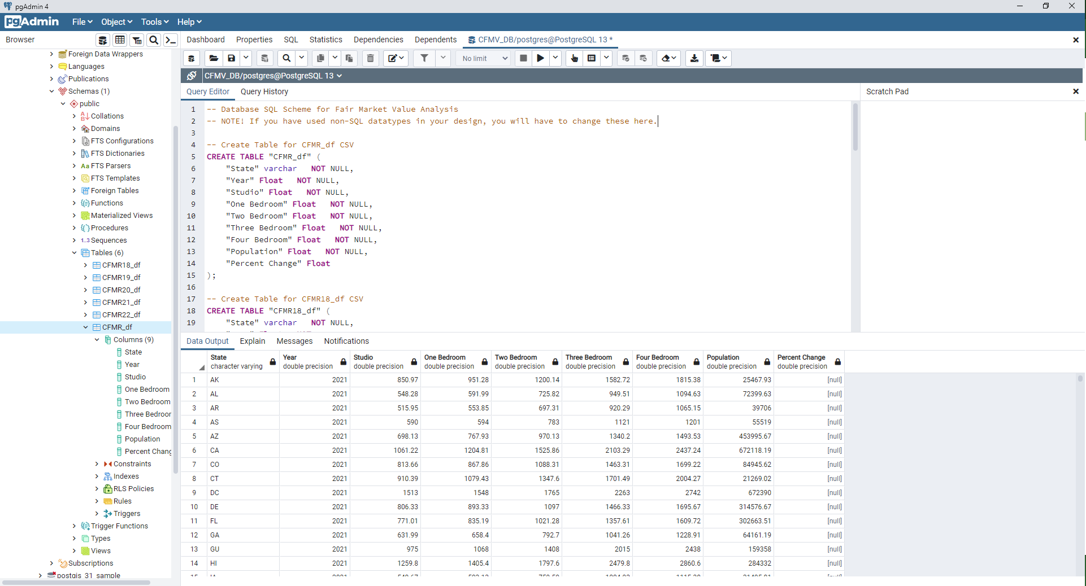
Database Explanation
Notes:
PostgreSQL Database Explanation.
Import data source which in our case was a CSV file
Create 6 Identical tables that store the cleaned data in sepereate columns as follows;
State, Year, Studio, One Bedroom, Two Bedrooms, Three Bedrooms, Four Bedroom, Population, Percentage Change
Static Database, Data warehouse is designed to gather, clean and store data for use.
No joins needed as we are using static data that does not change, so the main purpose is warehousing,
Joins are not used specifically because our data does not need/use combined rows from two or more tables, based on a related column between those tables. There are no need for a user to try to extract data from tables which have one-to-many or many-to-many relationships between them.
Data can be retrieved using simple SQL commands or queries.
Example : SELECT * FROM “CFMR18_df”;
.

Slide 11
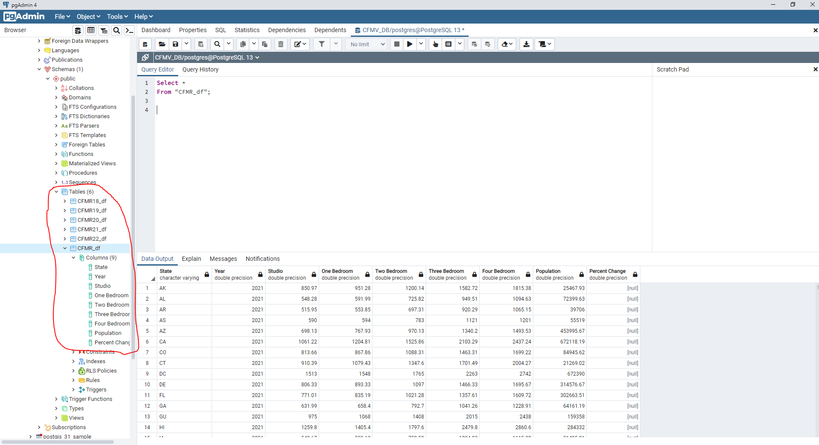
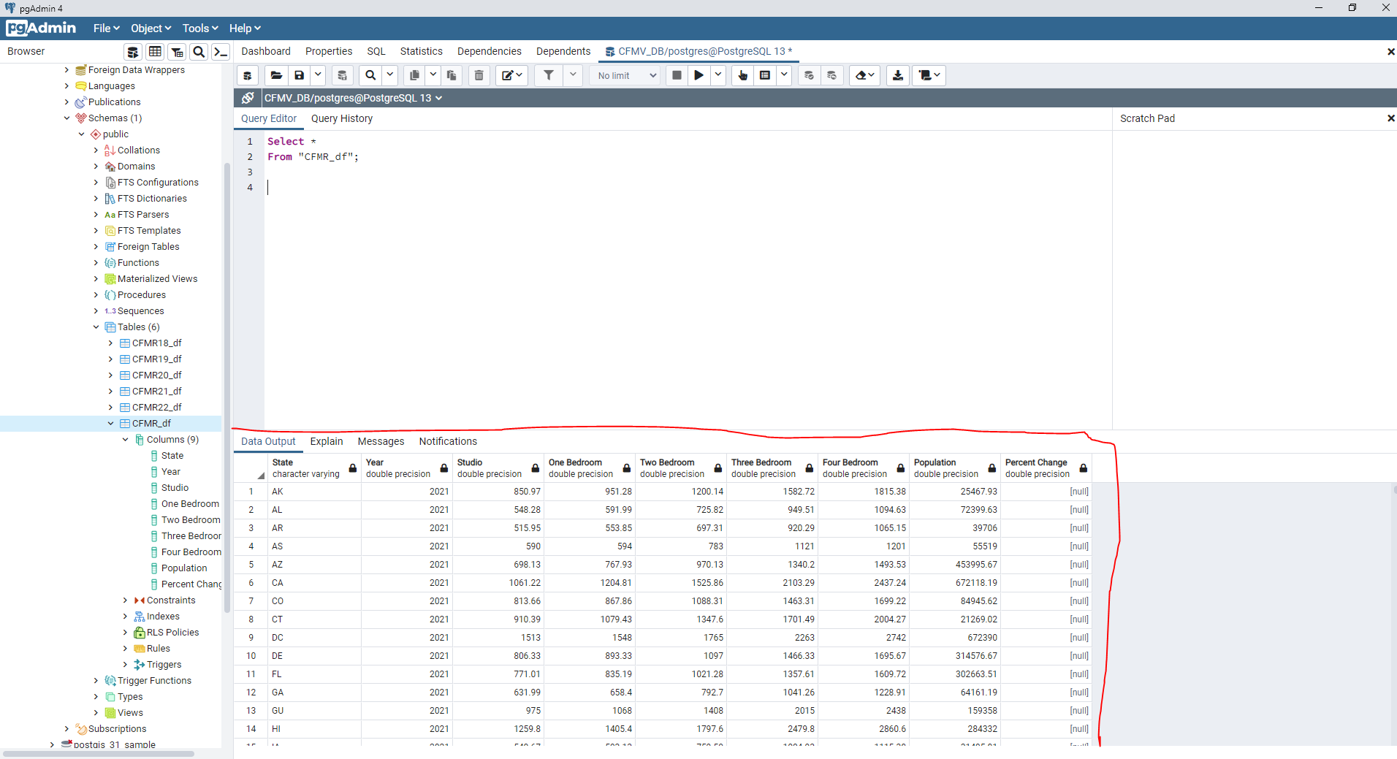
Database Explanation
Notes:
PostgreSQL Database Explanation.
SQL command results.
Create 6 Identical tables that store the cleaned data in separate columns as follows;
State, Year, Studio, One Bedroom, Two Bedrooms, Three Bedrooms, Four Bedroom, Population, Percentage Change
Static Database, Data warehouse is designed to gather, clean and store data for use.
Database is ready to store/retrieve more data and be used for alanysis.

Slide 12
Database Integration
Database stores cleaned HUD data sets for use
Database interfaces with the project by also storing the predictive models and connecting to the dashboard
Will include each cleaned year’s data set as well as combined cleaned static data for 2018-2022.
Tables will be joined on state to allow for dashboard to pull historic and predictive data together.

Slide 13
Machine Learning Models Tested
Simple Linear Regression Analysis
Gradient Boosted Regressor Model (GBR)
Quadratic Regression Model
The K-Nearest Neighbors (KNN) Regression Model

Slide 14
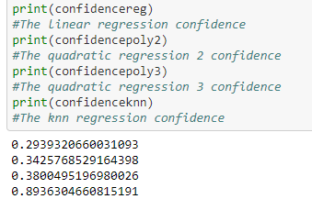
KNN Regression model provided highest confidence level
Notes:
Simple Linear Regression Analysis was used to identify the relationship between State Populations and their corresponding Rental prices for Studios, 1-Beds, 2-Beds, 3-Beds, & 4-Beds. Because we were limited by how many years of data we had (2018-2022), the averaged linear regression model gave us an R-Squared value of 0.26466134182163. This tells us the strength of population to predict price based on our data, it a relatively weak prediction.
We can see that for these weak predictions the models predictive ability was drastically increased with use of a Gradient Boosted Regressor Model (GBR) which increased the R-Squared value to an average of 0.95802951291603 which is either a very great fit or more likely--Overfitting to our model/data.
Quadratic Regression Model would be similar to Simple Linear Analysis, except that the model allowed polynomial (e.g: x squared) and would produce curves as opposed to a straight line and gave us an average R-Squared value of 0.31056686487748. This did demonstrate a stronger predictive ability vs the standard Linear Regression Model, but only a minimal improvement, but at least it is not overfitting to the data like the GBR Model.
The K-Nearest Neighbors (KNN) Regression Model provided a higher confidence level vs. any of the linear regression analysis (with the exception of the Gradient Boosted Regression). The KNN Regression model yielded the second highest confidence value of 0.89559359322488, almost on par with the Gradient Boosted Linear Regression from earlier but likely better as the GBR likely was overfitting our model quite heavily.

Slide 15
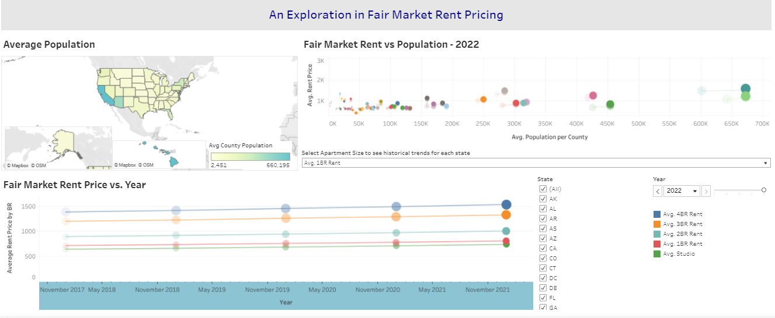
Tableau Dashboard

Slide 16
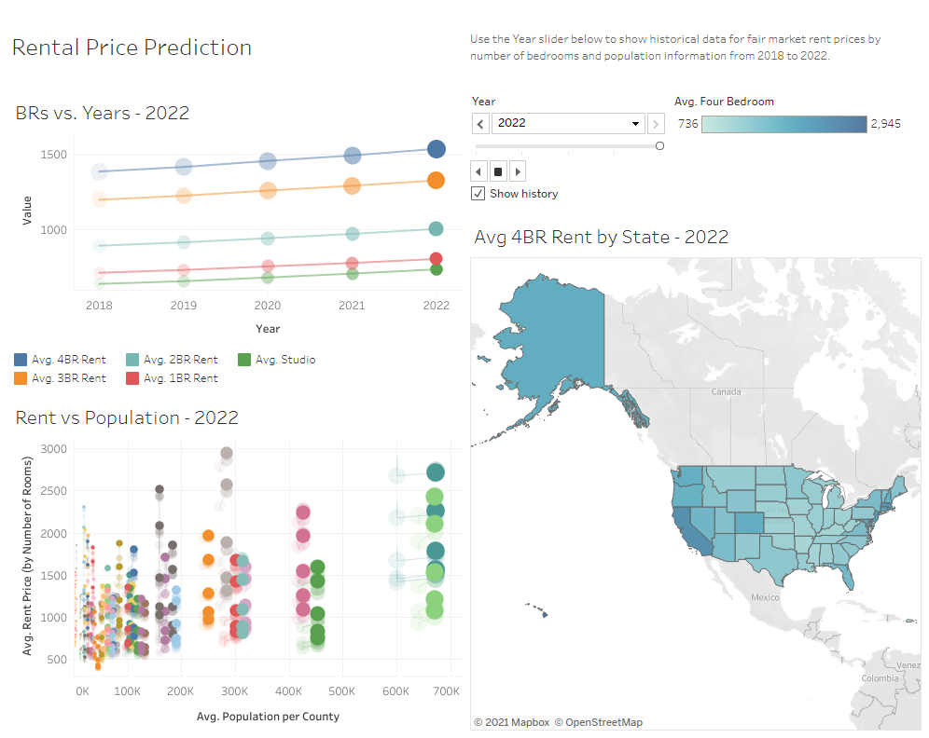
Dashboard Blueprint
The blueprint for our dashboard is shown to the right. It will be created on Tableau Public and will include 3-4 interactive elements:
The historic trend of bedrooms vs price over the years
Trend tile to view rent prices over the months/ years broken down by state, Population, and number of bedrooms. Each state is represented by a different color dot.
A map showing the change of rent prices throughout the years, broken down on the map by state. A filter will be added for number of bedrooms as well.
An animation/ year selection that will change or show trend throughout the years of each tile.

Slide 17
Results
The general overview of the data from a nationwide perspective appears as expected, with rent prices increasing at a gradual rate as time moves forward. We can take a look at a few individual states and see that HUD doesn’t just increase Fair Market Rent exponentially each year.

Slide 18
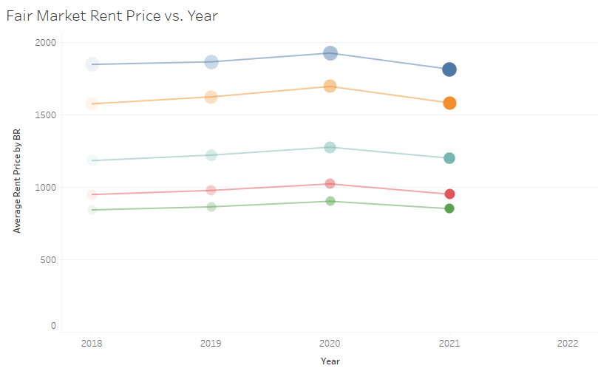
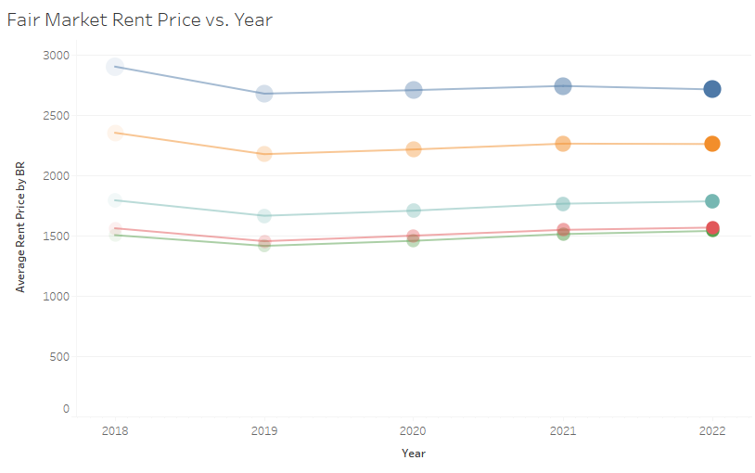
Fair Market Rent Decreases
Alaska
Washington DC

Slide 19
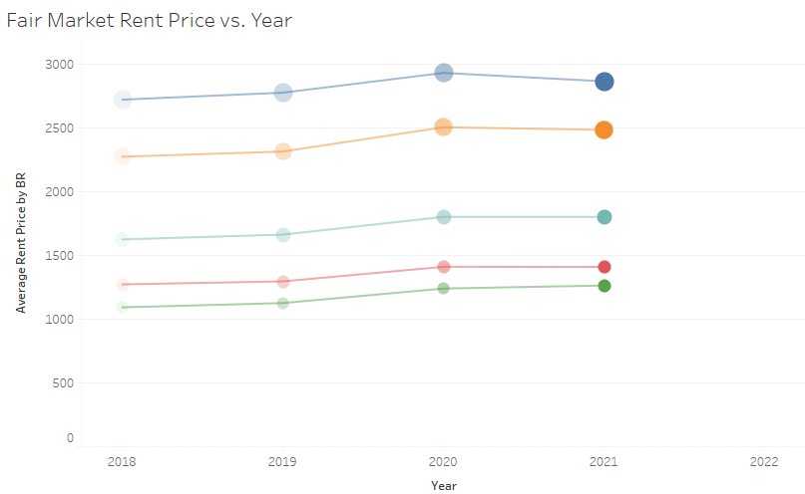
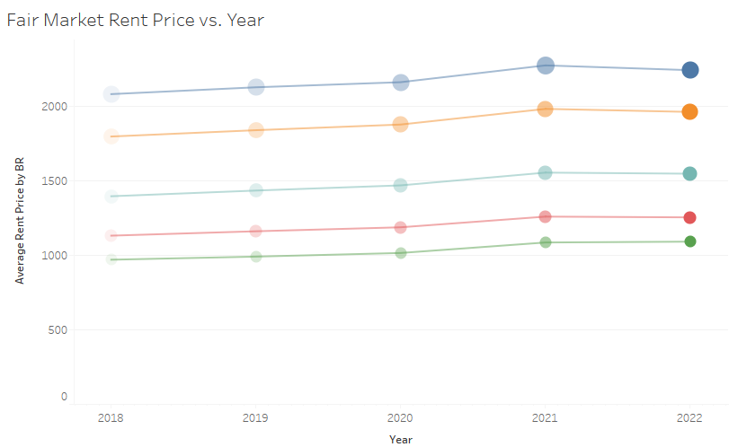
Decreases con’t:
Hawaii
New Jersey

Slide 20
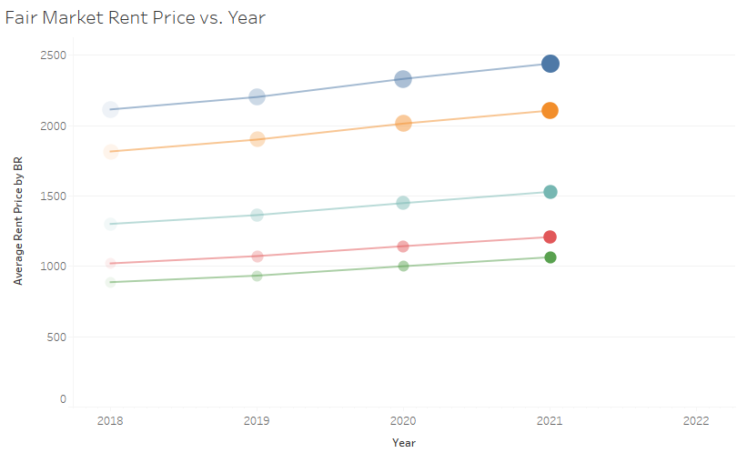
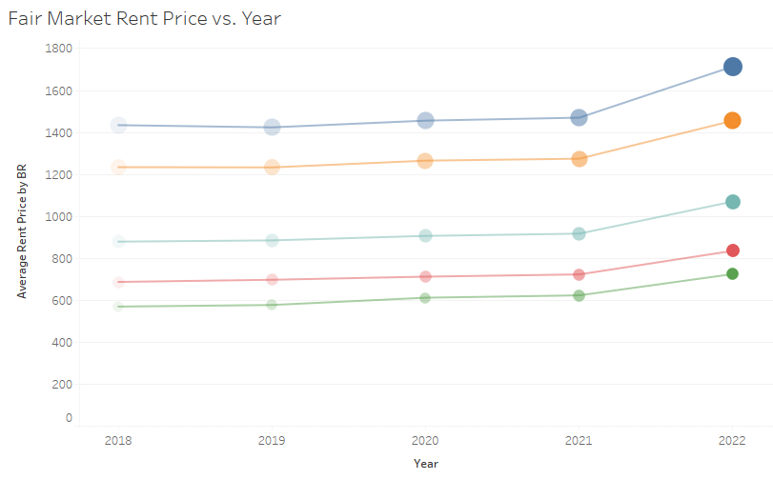
Fair Market Rent Increases
California
Nevada

Slide 21
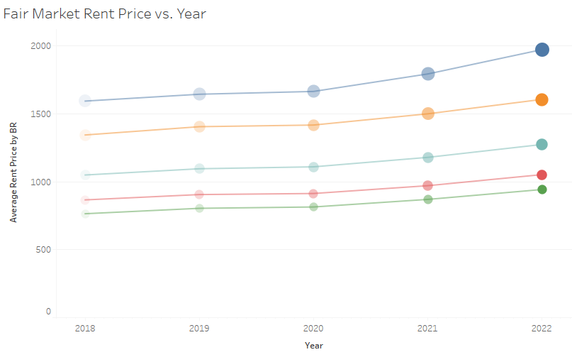
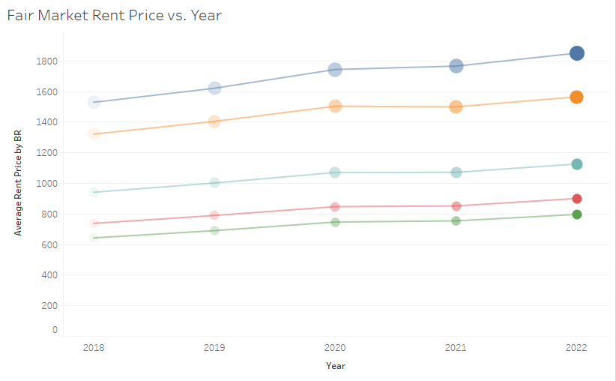
Increases con’t:
Washington
Rhode Island

